Slide 1
Reinforcement Learning-
Basic terminology

Slide 2
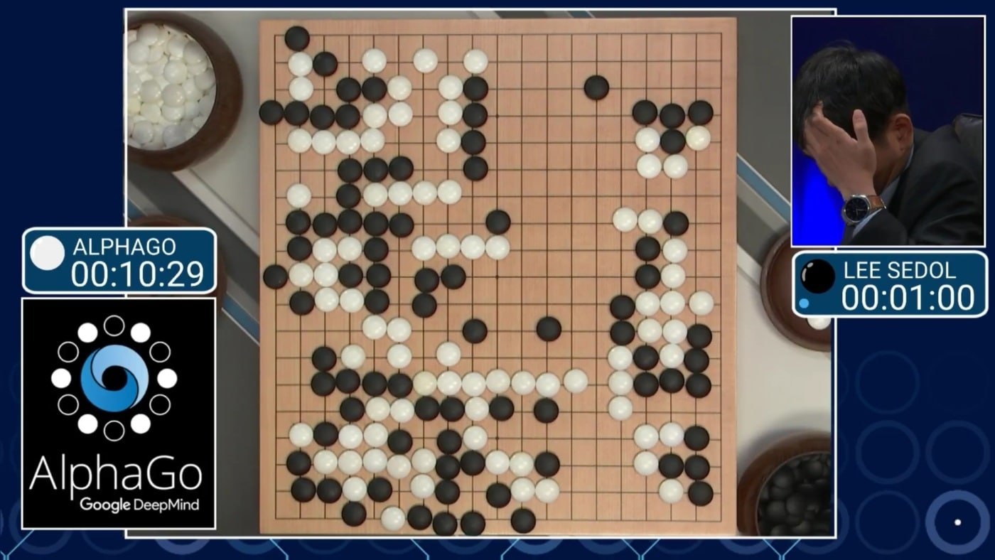
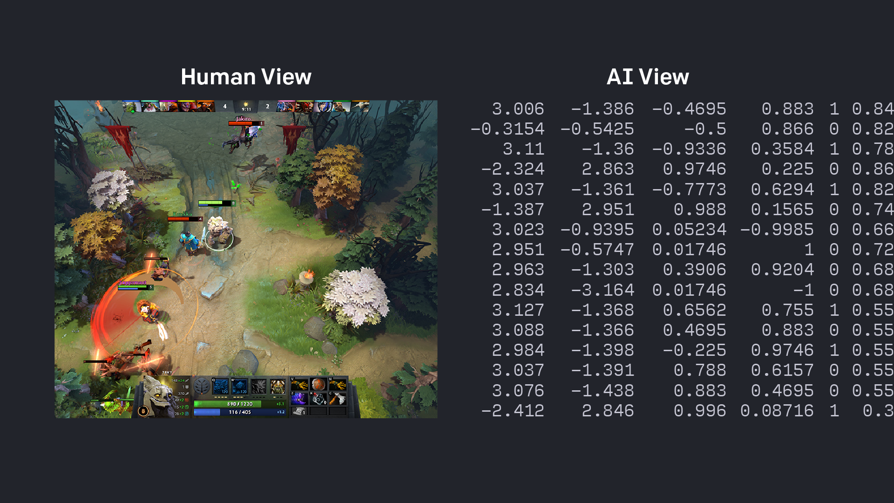
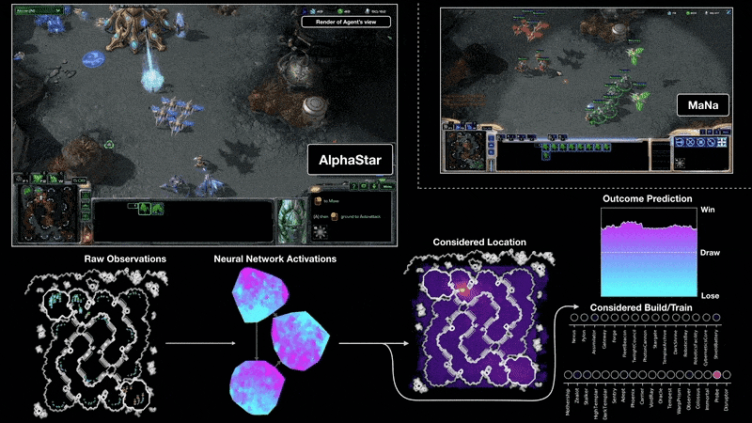
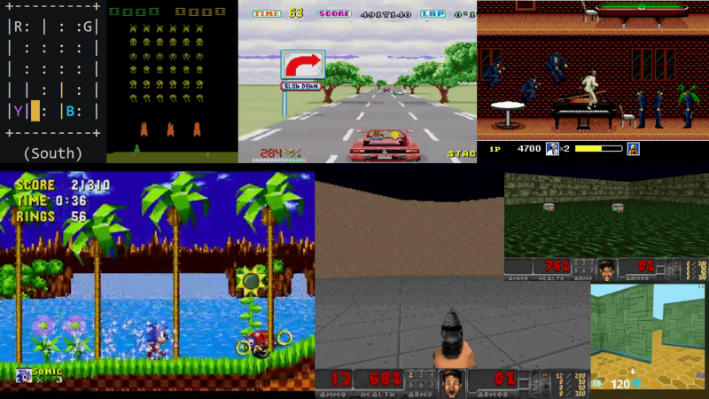

Slide 3
Elements of Reinforcement Learning
State, S_{t}
Agent
Reward, R_{t}
Action, A_{t}
R_{t+1}
Environment
S_{t+1}
Supervised learning: Data set is fixed.
Reinforcement learning: Agent only receives an outcome (state, reward) after an action.

Slide 4
Agent: AI player Environment: Screen

Slide 5
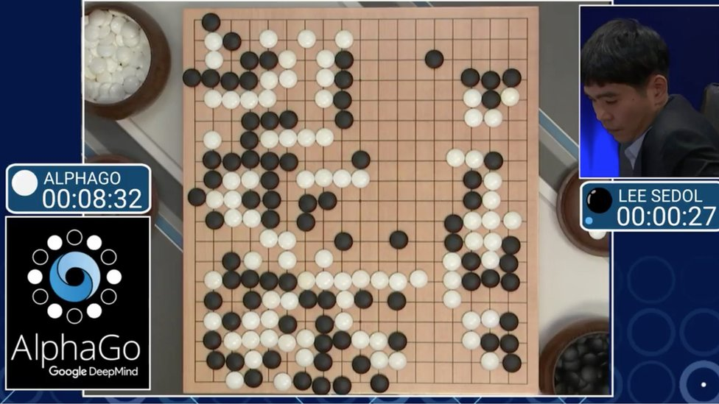
Agent: AlphaGo
Environment: Go game
Actions: a grid of placeable space (2D matrix)?
State: Current placement of stones (2D Matrix)
Reward: 0 until the end when you win or lose

Slide 6
Markov Decision Process
State, S_{t}
Agent
Reward, R_{t}
Action, A_{t}
S_{t+1}
Environment
R_{t+1}
Receiving Reward: f(S_{t},A_{t}) = R_{t+1}
t = time step
Markov decision process: a process of the state changing after an action
S₀
A₀
S₁
A₁
S₂
A₂
S₃
A₃
S₄
A₄
S₅
A₅
S₆
A₆
…

Slide 7
Terminologies
Expected Return
We want actions to maximize its cumulative (expected) rewards
Fails for infinite continuous process
(e.g. stock prediction)
$$G_{t}=R_{t+1}+R_{t+2}+R_{t+3}+…+R_{T}$$
Discounted Return
The discount rate, γ, discounts (lowers) future rewards, so model focuses more on the present
$$G_{t}=R_{t+1}+γR_{t+2}+γ^{2}R_{t+3}+…=\sum_{k=0}^{∞}{γ^{k}R_{t+k+1}}$$
$$G_{t}=R_{t+1}+γR_{t+2}+γ^{2}R_{t+3}+…=R_{t+1}+γ(R_{t+2}+γR_{t+3}+…)=R_{t+1}+γG_{t+1}$$

Slide 8
More Terminologies
Policy
If an agent follows policy π at time t, then π(a|s) is the probability that A_{t} = a if S_{t} = s
Value Function
how good is a specific action or a specific state for the agent?
State-value function for policy π, or v_{π}, is a measure of the goodness of a state for an agent following policy π
$$v_{π}\left(s\right)=E\left[G_{t} | S_{t}=s\right]$$
Action-value function for policy π, or q_{π}, is a measure of the goodness of an action given a state for an agent following policy π
$$q_{π}\left(s\right)=E\left[G_{t} | S_{t}=s,A_{t}=a\right]$$
q value
q function

Slide 9
Optimal policy
Optimal Policy
$$π≥π^{′} if and only if v_{π}\left(s\right)≥v_{π^{′}}\left(s\right)for all s∈S$$
A policy that is better than or at least the same as all other policies is called an optimal policy
$$v_{∗}\left(s\right)=\max_{π}{v_{π}\left(s\right)} q_{∗}(s)=\max_{π}{q_{π}(s,a)}$$
* indicates the optimal
Bellman optimality equation for q*
$$q_{∗}(s,a)=E[R_{t+1}+γ\max_{a^{′}}{q_{∗}\left(s^{′},a^{′}\right)}]$$
Reward for s,a
Maximum q value from next actions
We need to train q to become q*

Slide 10

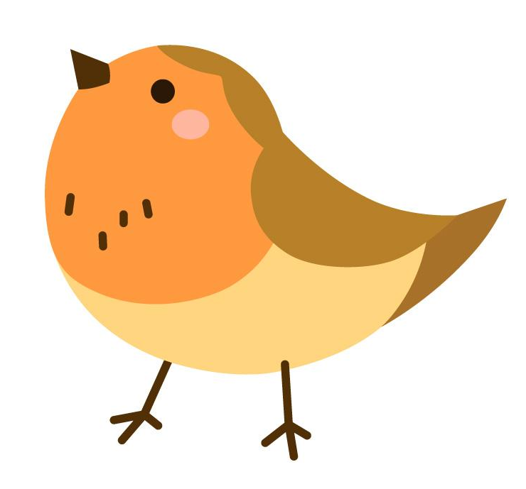
Example
ε-greedy strategy
if u(0,1) < ε, take random action.
Bellman Optimality
$$q_{∗}(s,a)=E[R_{t+1}+γ\max_{a^{′}}{q_{∗}\left(s^{′},a^{′}\right)}]$$
 | Action
State | → | ← | ↑ | ↓
A flower
Empty 1
Empty 2
Empty 3
Bird
Empty 4
Empty 5
Empty 6
Flowers
-1
-1
+1
Loss and update
$$q_{∗}\left(s,a\right)−q \left(s,a\right)=loss$$
$$q^{new}\left(s,a\right)=\left(1−α\right)q \left(s,a\right)+α\left(R_{t+1}+γ\max_{a^{′}}{q_{∗}\left(s^{′},a^{′}\right)}\right)$$
$α$: Learning rate
-5
-1
-1
+5
-1
Images by Freepik

Slide 11
Reinforcement Learning-
Deep Q Network

Slide 12
Challenges of q learning
 | Action
State | → | ← | ↑ | ↓
A flower
Empty 1
Empty 2
Empty 3
Bird
Empty 4
Empty 5
Empty 6
Flowers
-1
-1
+1
-5
-1
-1
+5
-1
Possible actions and states are fairly small for this case. What if it’s large?

Slide 13
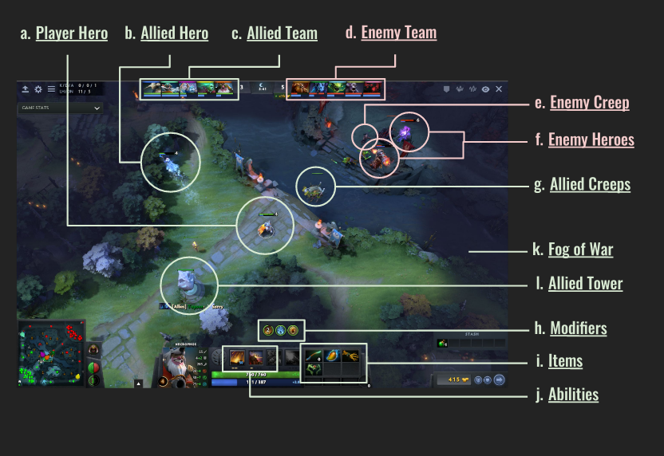
Dota 2 with Large Scale Deep Reinforcement Learning

Slide 14
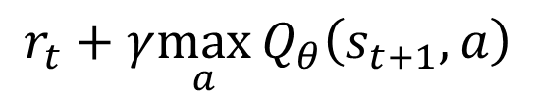
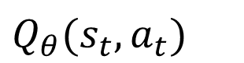
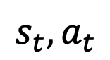
Deep Q network (DQN) Concept
q* - q = loss
q(s,a₁)
q(s,a₂)
State
q(s,a₃)
q(s,a₄)
…
NN
Fitting
$$s_{t},a_{t}$$
$Q_{θ}(s_{t},a_{t})$
$$r_{t}+γ\max_{a}{Q_{θ}\left(s_{t+1},a\right)}$$

Slide 15
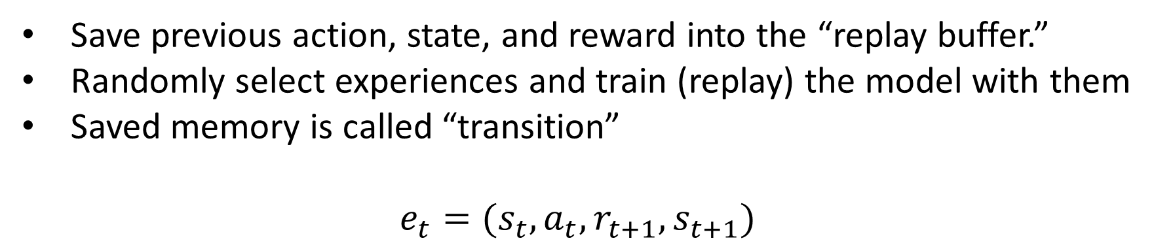
Experience Replay
Save previous action, state, and reward into the “replay buffer.”
Randomly select experiences and train (replay) the model with them
Saved memory is called “transition”
$e_{t}=(s_{t}, a_{t},r_{t+1},s_{t+1})$

Slide 16
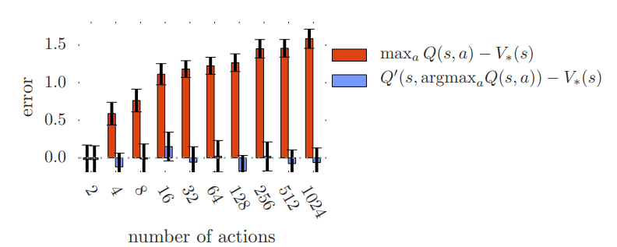
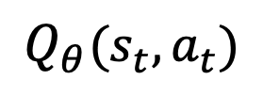
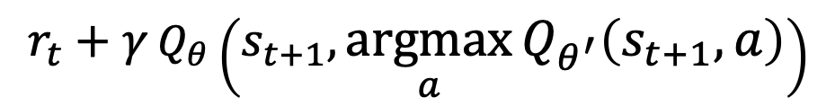
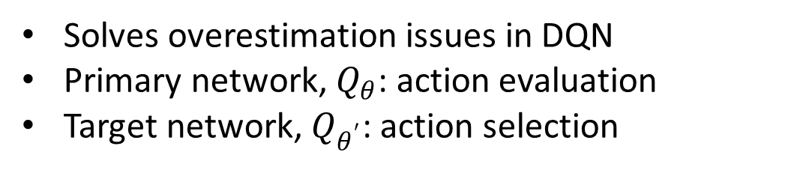
Double Q Learning
Solves overestimation issues in DQN
Primary network, $Q_{θ}$: action evaluation
Target network, $Q_{θ^{′}}$: action selection
Fitting
$Q_{θ}(s_{t},a_{t})$
$$r_{t}+γ{Q_{θ}\left(s_{t+1},\underset{a}{argmax}{Q_{θ^{′}}\left(s_{t+1},a\right)}\right)}$$
https://arxiv.org/pdf/1509.06461.pdf

Slide 17
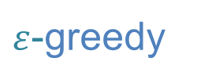
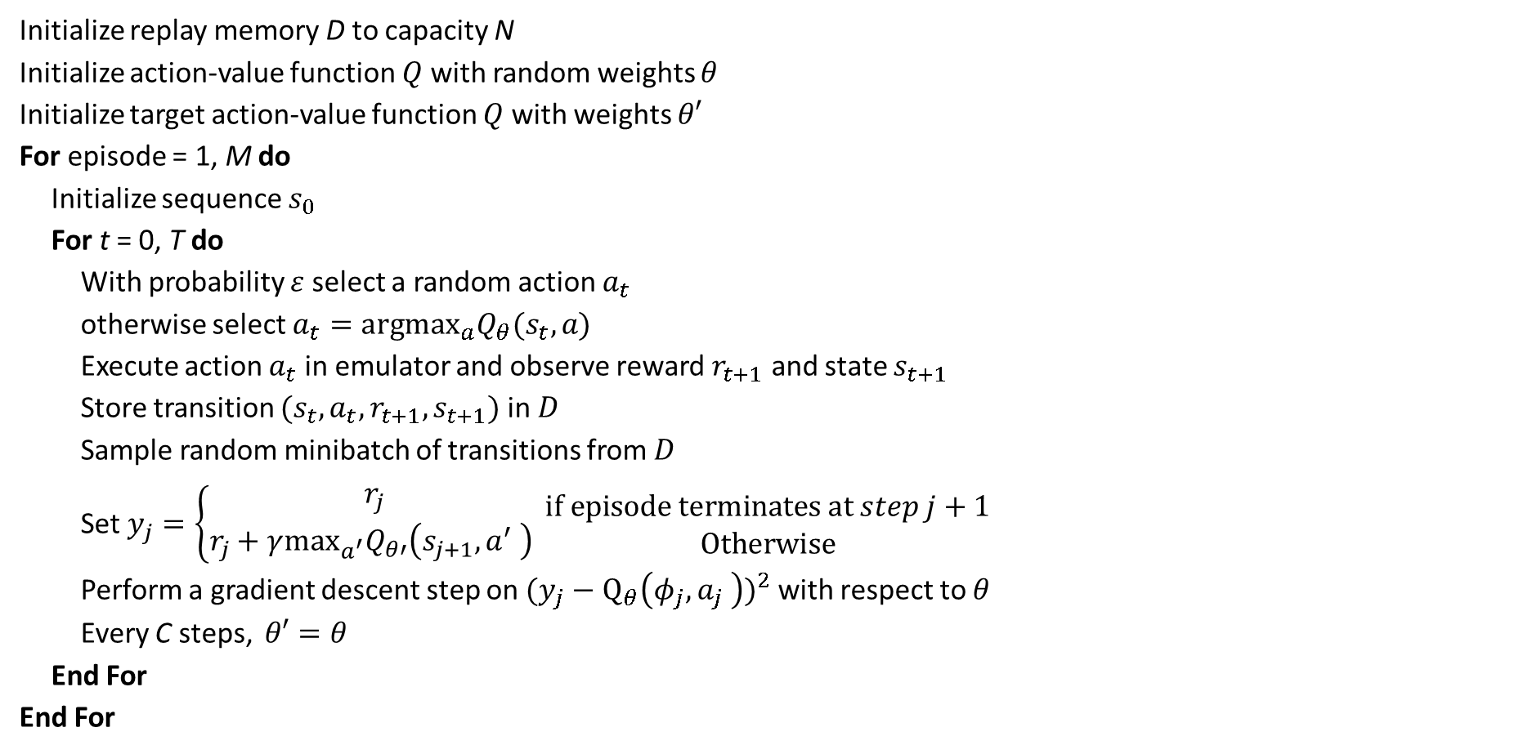
DQN Entire Algorithm
Initialize replay memory D to capacity N
Initialize action-value function $Q$ with random weights $θ$
Initialize target action-value function $Q$ with weights $θ′$
For episode = 1, M do
Initialize sequence $s_{0}$
For t = 0, T do
With probability $ε$ select a random action $a_{t}$
otherwise select $a_{t}={argmax}_{a}Q_{θ}(s_{t},a)$
Execute action $a_{t}$ in emulator and observe reward $r_{t+1}$ and state $s_{t+1}$
Store transition $(s_{t}, a_{t},r_{t+1},s_{t+1})$ in $D$
Sample random minibatch of transitions from $D$
Set $y_{j}=\left\{\begin{aligned}r_{j} \\ r_{j}+γ\max_{a^{′}}Q_{θ′}\left(s_{j+1},a^{′} \right) \end{aligned}\right.\begin{matrix}if episode terminates at step j+1 \\ Otherwise\end{matrix}$
Perform a gradient descent step on ${(y_{j}−Q_{θ}\left(φ_{j},a_{j} \right))}^{2}$ with respect to $θ$
Every C steps, $θ′=θ$
End For
End For
$ε$-greedy
Playing
Experience replay
Bellman Optimality
Training
DDQN

Slide 18
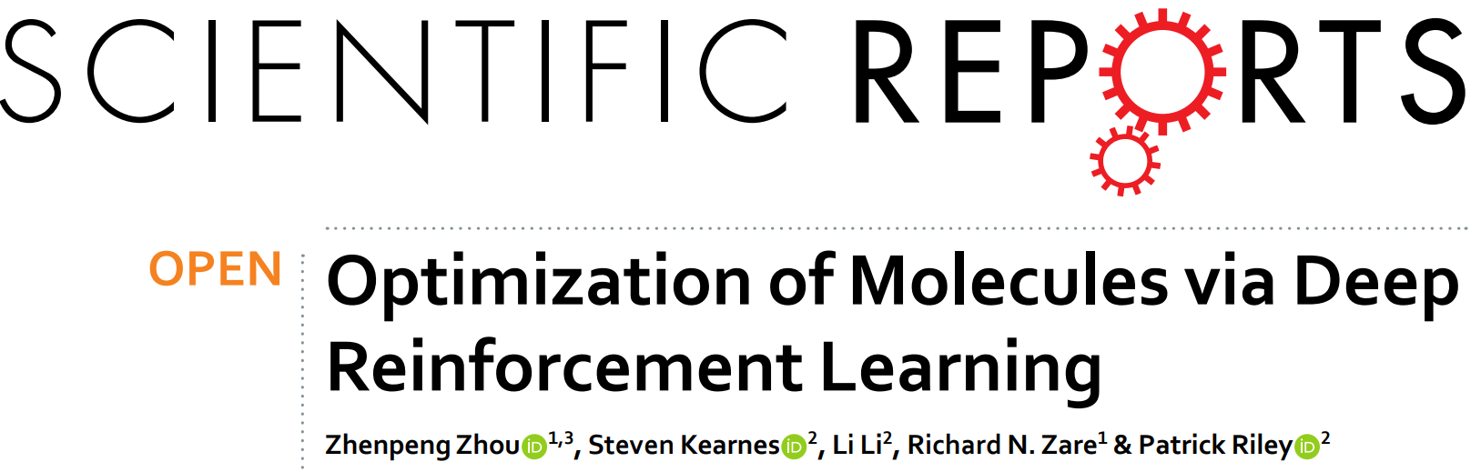
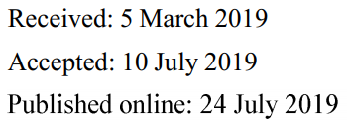

Slide 19
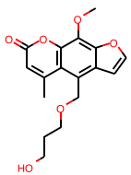
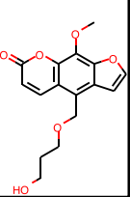
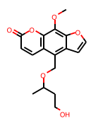
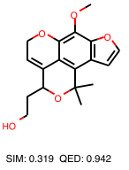
Reinforcement learning for de novo design
Generated Data
SIM = 0.722
QED = 0.556
w=1.0
SIM:QED = w:1-w
SIM = 0.667
QED = 0.704
w=0.6
Base molecule
(QED = 0.556)
SIM = 0.319
QED = 0.942
w=0.2

Slide 20
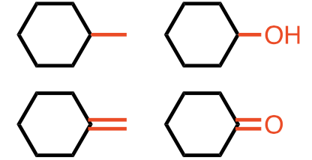
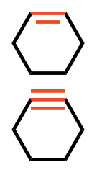
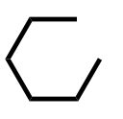
Reinforcement learning for de novo design
Molecule modification & Markov decision process (MDP)
S: state space (molecule, all generated states are valid)
A: action space (consider only valid molecular modification)
R: reward space (property or objective function)
Various state transition from initial state (cyclohexane)
State
Action
Atom addition
Bond addition
Bond removal

Slide 21
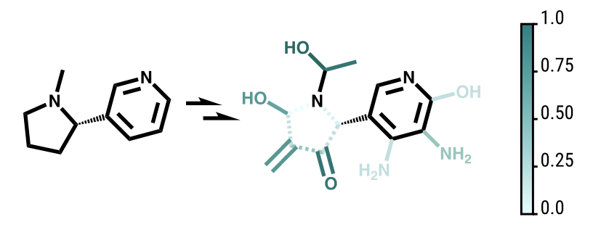
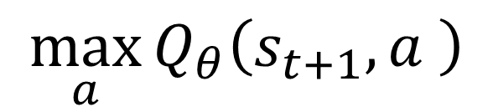
Model Prediction Example
$$\max_{a}{Q_{θ}\left(s_{t+1},a \right)}$$

Slide 22
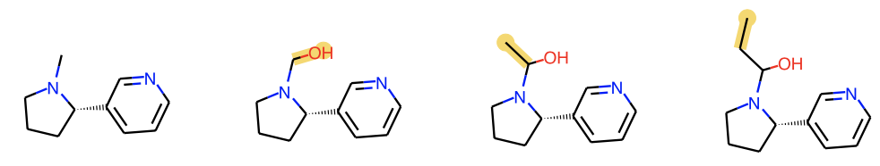
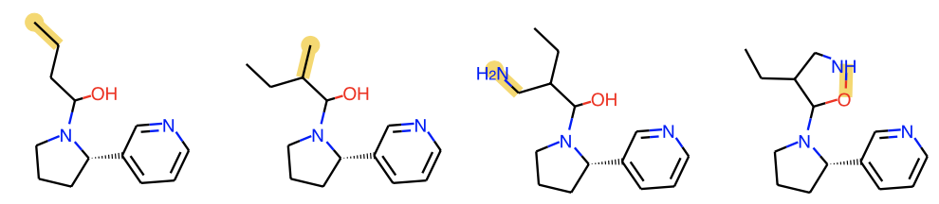
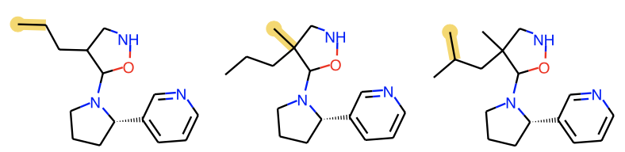
Molecular generation with Q-network
Start
QED-optimization
End

Slide 23
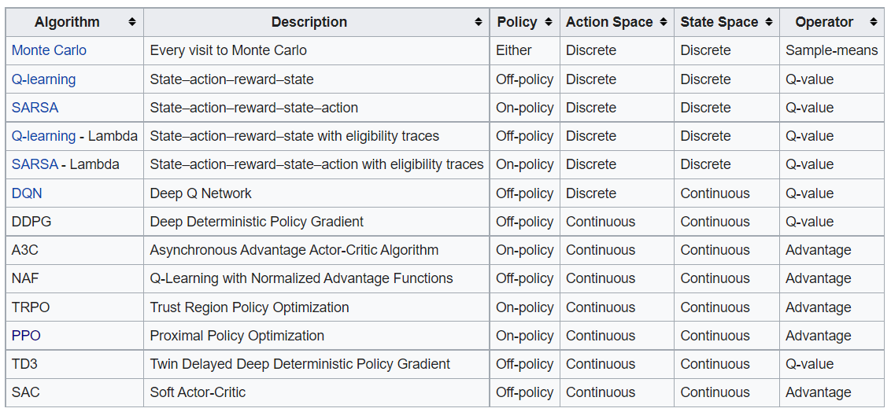
DDQN is Accessible, but Literature is Ample
https://en.wikipedia.org/wiki/Reinforcement_learning

